Slide 1
Workshop 3

Slide 2
Objectives
Recap on Hula Drone handling and coding hula drone
Review a Workshop 2 Quiz question
Breakout session:
Some quiz on hula handling and python coding
Q&A

Slide 3
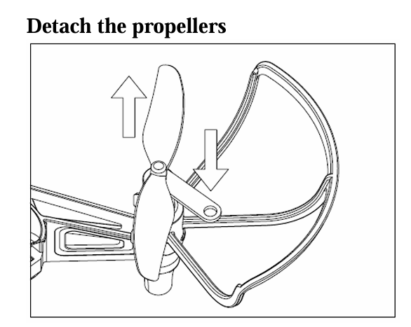
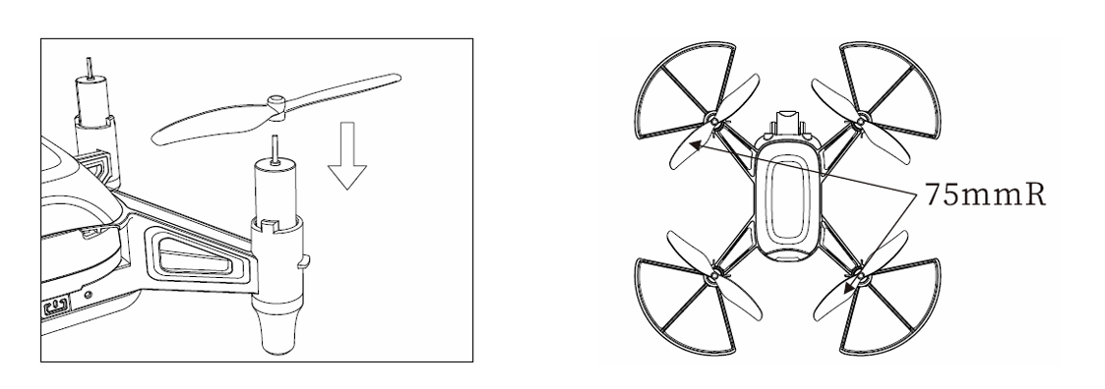
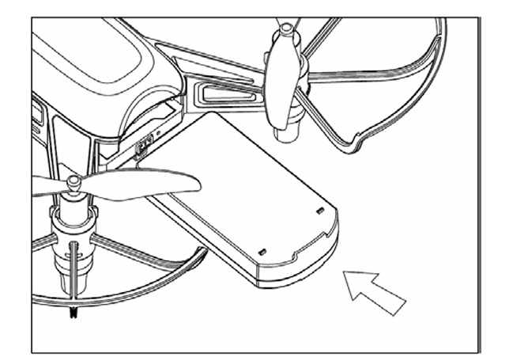
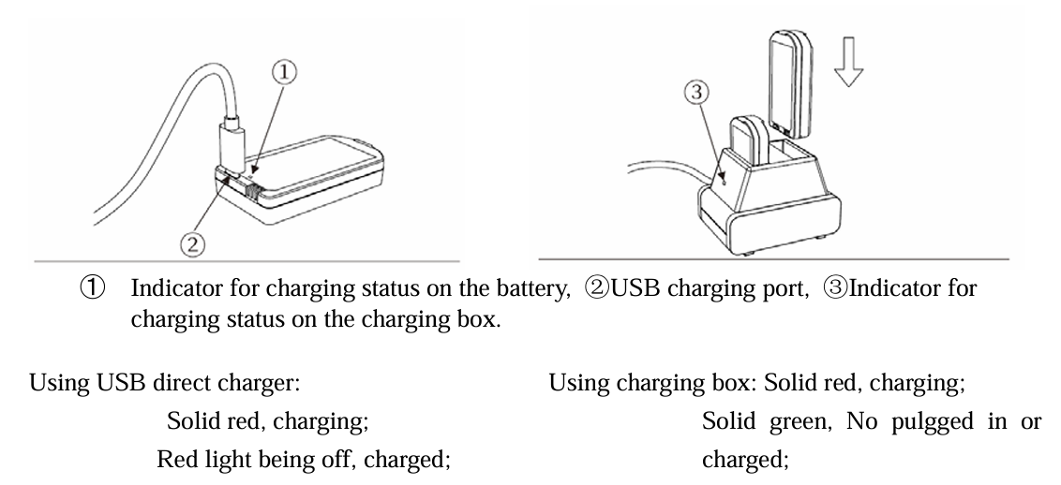
Hula Drone - Pre-flight check
Make sure all propellers are in good condition. Replace if needed. Detach propeller using propeller removal tool
Make sure correct propeller at correct motor.
Make sure battery are fully charge.
Install battery fully into the drone.
Know your drone’s WIFI ssid

Slide 4
Hula Drone: Watch drone LED to ensure drone is ready
Refer to https://drive.google.com/file/d/1dqT7F9za-WpyJhDSgR-MRHtsQPYQJgIw/view?usp=sharing

Slide 5
Python coding with Hula and some tips
MOST IMPORTANT: import pyhula
Refer to https://drive.google.com/file/d/1FoxWyoOp9J7eRHlXxWOF9DPtCBA2lemK/view?usp=sharing for methods to control hula drone.
When using LED parameters or setlamp, the R is actually G, G is actually B and B is actually R. One of the school gave us this feedback. Thanks ACS(I) team.
When you want to make the drone land halfway during your code execution, you can disconnect your laptop’s wifi from the drone and the drone will slowly land.
Drone will not takeoff if the battery level is below 30% or when you see red light on the drone.

Slide 6
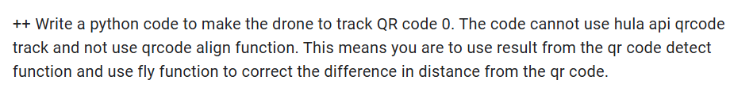
Workshop 2 Quiz Review - A useful flight command
Most questions are correctly answer.
Let’s look at the last Optional coding question:

Slide 7
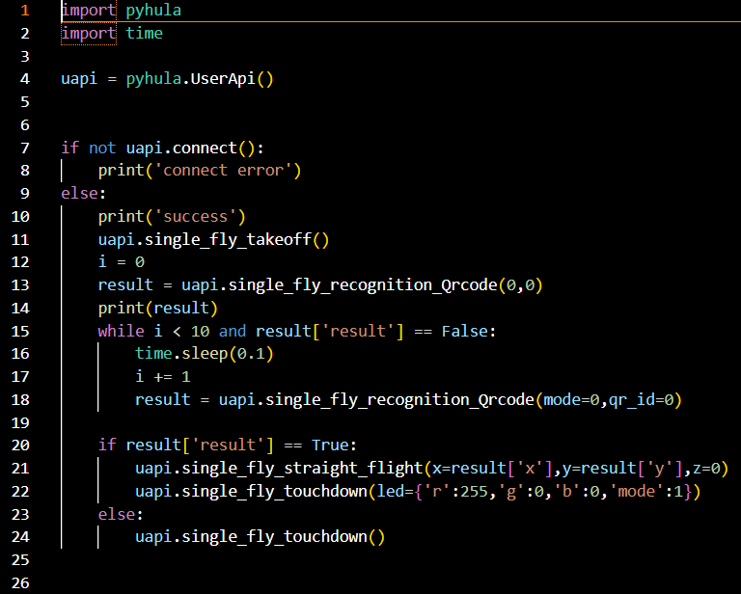
Workshop 2 Last Question Answer
Line 21: single_fly_straight_flight command flies the drone to a specific x, y coordinate. The coordinate is with respect to the drone body.
QRcode recognition also tells where is the QR code marker with respect to the drone.
Straight_flight x coordinate orientation:
Left of drone is negative x
Right of drone is positive x
Straight_flight y coordinate orientation:
Back of drone is negative x
Front of drone is positive x
The straight_fly_straight_flight can be useful when wanting the drone to fly diagonally towards a point.

Slide 8
Recap with Quiz
15 minutes to complete Workshop 3 quiz
Thereafter you will be assigned to respective breakout room, the instructor will go through the quiz and for you to ask more questions.

